Slide 1
Notes:
The facilitators should introduce themselves, welcome and thank everyone for attending.
Give some information about your personal connection to the issues of alcohol overdose and/or hazing (e.g., you want to keep students/peers safe, help people understand the risks of hazing, etc.)

Slide 2
Notes:
National GORDIEday is celebrated every September on the Thursday of National Hazing Prevention Week, which is sponsored by the Hazing Prevention Network.
It serves as a day of remembrance for Gordie Bailey, and a way to raise awareness about the dangers of hazing and alcohol overdose.

Slide 3
Notes:
We’re going to take a minute to learn about Gordie Bailey’s story by listening to this short video.
PRESENTER NOTE: The slide has a hyperlink to the video that tells Gordie’s story. If you use the video link, then delete the next slide. You can access the video directly at:
https://youtu.be/um2xLIxF8ng
OR you can either read the script below.
Audio script:
Gordie Bailey died in his 3rd week of college. He was 18 years old. Gordie was a friendly, well-liked, funny, athletic guy. He had a younger sister who adored him and was close to his parents and step-parents. In high school, he created a Hug Club with his friends, because he thought any problem could be solved with a hug. He was always making everyone laugh, played guitar, acted in the school plays, and made films for fun. His family fully expected him to be an actor or film director someday. In his 3rd week of college, Gordie received a bid to join a fraternity. He called his parents to share the news that he accepted the bid and would be going to his first event that night and also that he had been chosen for the club lacrosse team. Gordie was excited about both groups and was feeling confident about fitting in at a school far from home.

Slide 4
Notes:
PRESENTER NOTE: Delete this slide if you use the hyperlink to the video of Gordie’s story on the previous slide.
Audio script: That evening, Gordie and twenty-six other fraternity pledges, dressed in coats and ties for bid night, were blindfolded and taken to the woods far from campus to meet with fraternity alumni. The pledges were given four handles of whiskey and six bottles of wine to drink around a bonfire. The pledges were told they needed to finish the alcohol before their ride back to the fraternity house left in 30 minutes. When the group returned to the fraternity house, Gordie was visibly drunk and was placed on a couch to "sleep it off“ with a bucket in case he threw up. It was 11pm. Fraternity brothers and pledges wrote all over his body with permanent markers--a fraternity ritual meant to embarrass brothers who pass out. A fellow pledge (who had thrown up multiple times from drinking too much alcohol during the event) checked on Gordie around 4am before leaving the fraternity house to walk back to their dorm. He heard Gordie snoring loudly, assumed Gordie was okay, and left. When the brothers next checked on Gordie at 9am, he was already gone. He was face down on the floor next to the couch. He wasn’t breathing. His face was blue. His blood alcohol content (or BAC) was 4 times the legal limit. No one called for help until it was too late.

Slide 5
Notes:
Gordie’s death could have been prevented at many different times the night he died.
Even if someone doesn’t lose their life, the hidden mental harm of hazing “traditions” can last a lifetime.
We want you to learn what you could do if you’re in a similar situation.

Slide 6
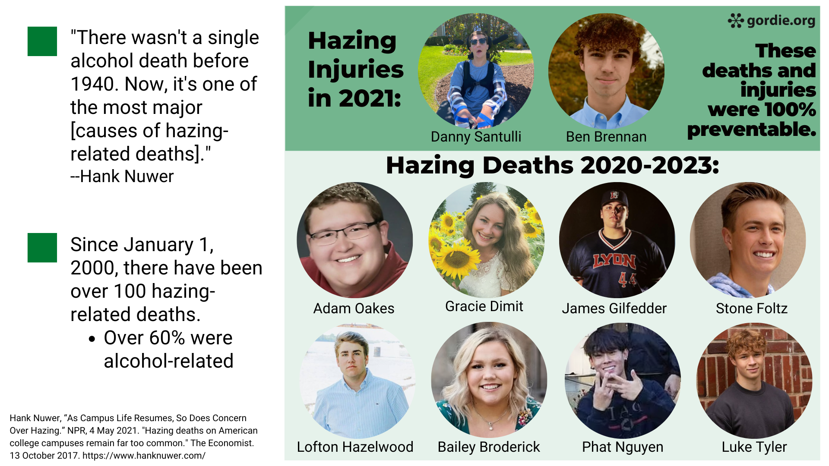
Notes:
What happened to Gordie 20 years ago (in 2004) has happened to far too many other students. EACH ONE was completely preventable.
In the past two decades, over 100 people have lost their lives due to hazing in the U.S. while others have been seriously injured.
In 2021, VCU student Adam Oakes also died on fraternity bid night after an alcohol-related hazing ritual and then was left alone to sleep it off. No one called for help.
If someone had called for help, Gordie, Adam, and so many others would still be alive.

Slide 7
Notes:
The most significant, preventable issue that can put your organization at risk is hazing.
Hazing undermines your group’s values. Most importantly, hazing puts members’ health and safety in danger.

Slide 8
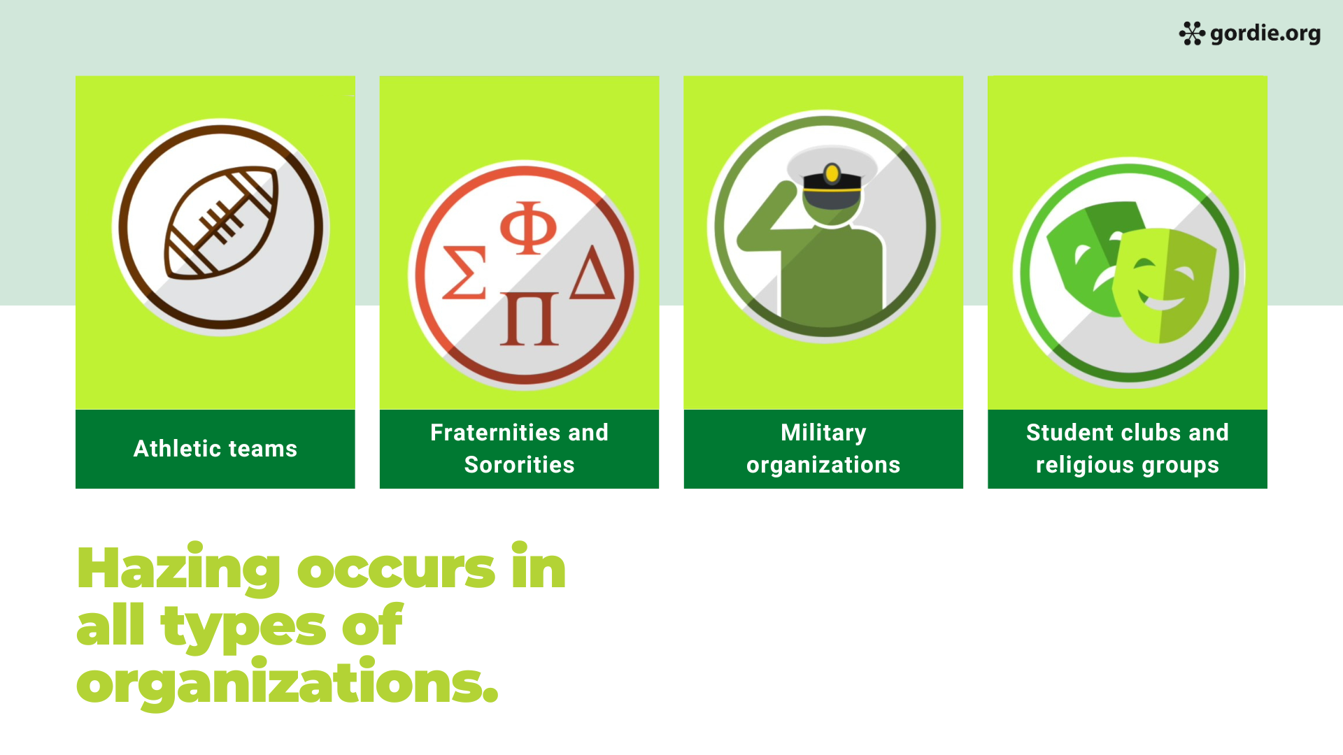
Fraternities ad Sororities
Student clubs and religiousgroups
Athletic teams
Notes:
Hazing can happen in any organization in which there is a hierarchy.
People often think of groups like athletic teams, the military, and fraternities and sororities, but hazing also happens in academic clubs, performing arts groups like marching bands, and even faith-based groups.
Many students falsely believe that enduring hazing is just what you have to do to belong and fit in.
And unfortunately, some students have already experienced hazing when they enter college – and even by the time they start high school.

Slide 9
Notes:
Gordie might not have consumed so much alcohol the night he died if the activity hadn’t also included hazing.
ASK → How would you define hazing?
Gather a few responses, using one of the formats below:
Use an online participant response systems (e.g., Mentimeter.com) to receive real-time responses and show them through your PowerPoint slides. A basic Mentimeter account is free.
Ask students to turn to a neighbor and share their thoughts, then ask for volunteers to share with the whole group. If delivering the program online, put students in breakout rooms, and ask for one person to submit a group response through chat once everyone returns to the main room.
Ask the entire group for ideas on what hazing is and invite students to share their thoughts. If delivering online, invite students to submit through chat.

Slide 10
Notes:
Let’s make sure we all have a basic understanding of what hazing is:
There are 3 components:
Group context (related to joining or maintaining membership in a group)
Humiliating, degrading, or endangering behavior
Regardless of consent
ASK: “What do you notice, find interesting, or find confusing about this statement?”
Most audiences will focus on the consent aspect and the phrase: "regardless of a person’s willingness to participate” as something they had not really considered before.

Slide 11
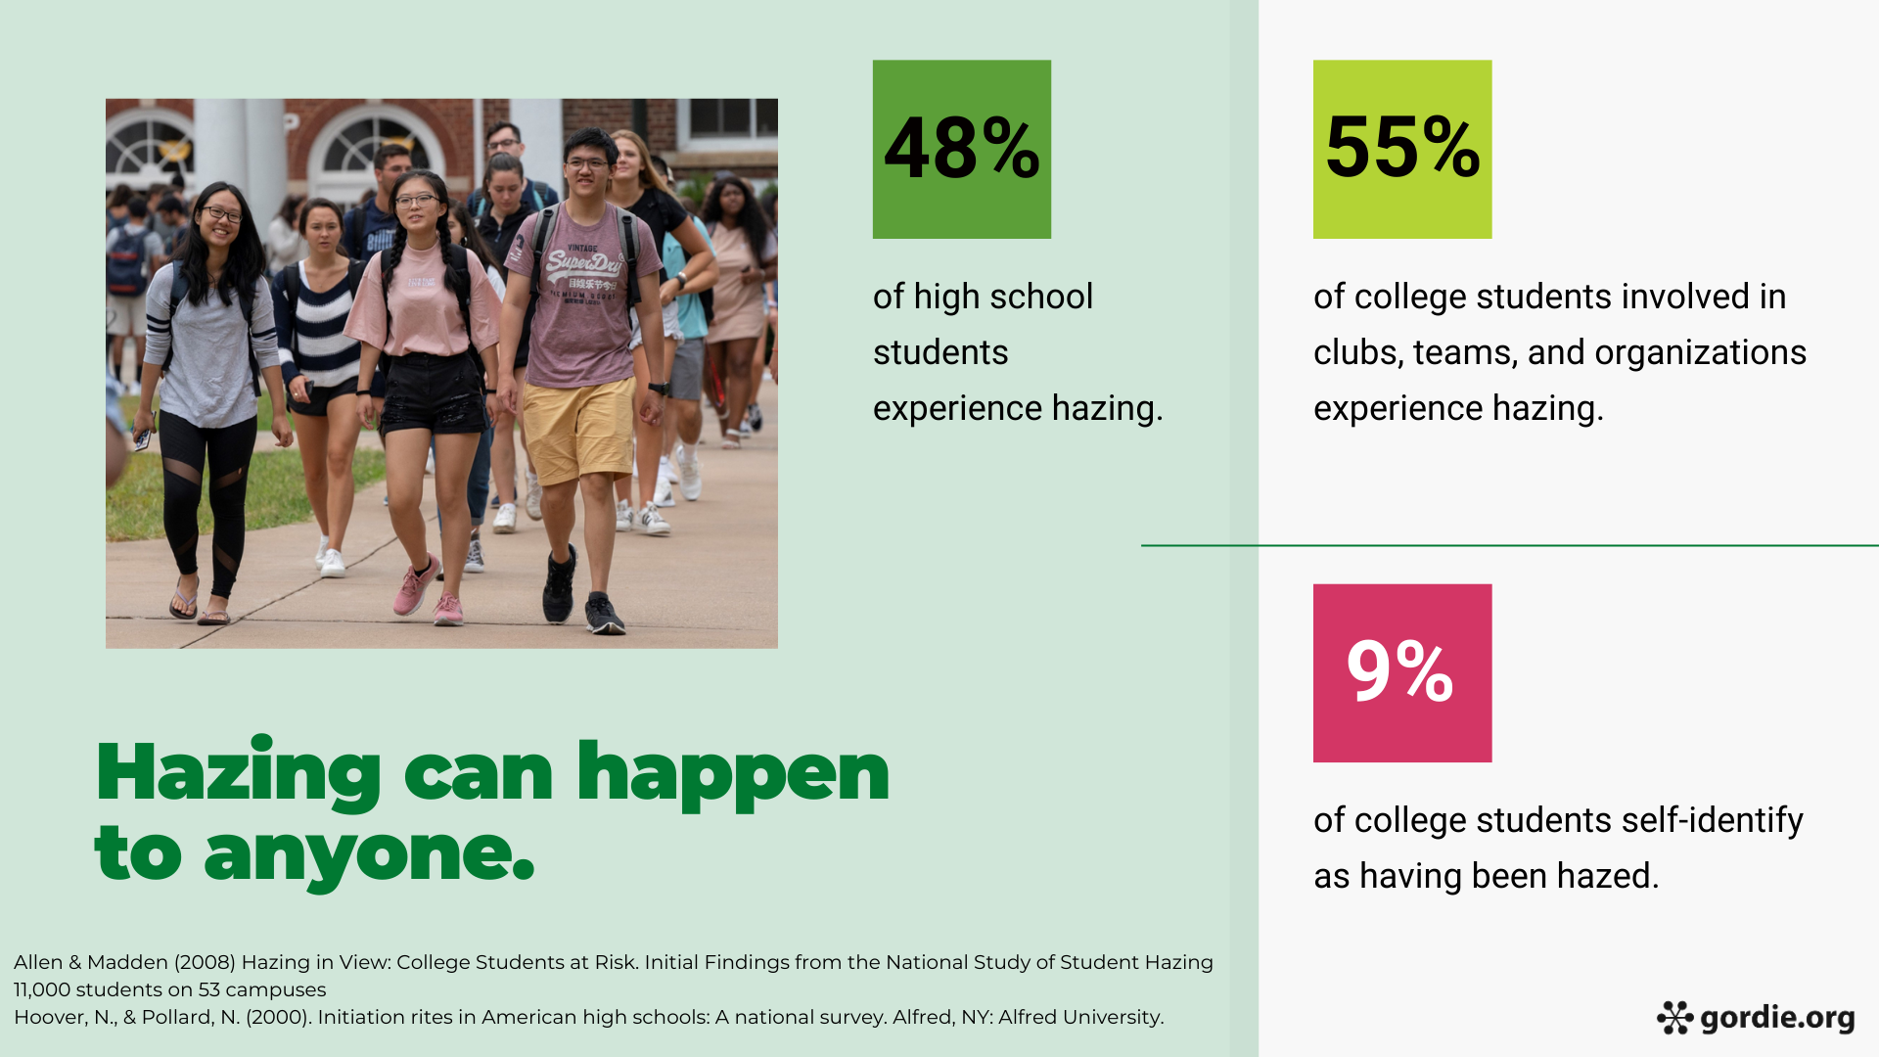
Notes:
Hazing really can happen to anyone -- it has nothing to do with strength or weakness, likeability, or popularity.
In a large national survey of college students, a little over half report being hazed, so we know that applies to many of you.
This is a national problem that we’re working to end on campuses across the country.
It’s striking that only a very small percent of those students who WERE hazed, believe they were hazed. Let’s look at why that might be.
Source: Hazing in View: College Students at Risk. Initial Findings from the National Study of Student Hazing (2008) Allen & Madden
-More than 11,000 students from 53 universities and colleges participated in this research.
-Data collection involved an on-line survey sent to a random sample of undergraduate students enrolled at participating institutions.
-Researchers also made campus visits and conducted interviews with more than 300 individuals including students, staff, and administrators at 18 campuses
-55% of college students involved in clubs, teams, and organizations experience hazing and were asked follow-up questions about their perceptions, including if they believe they had been hazed.

Slide 12
Notes:
There are many hazing behaviors, but they tend to impact people in similar ways.
The Gordie Center created a video to help students understand hazing signs for friends (and themselves!)
The slide has a hyperlink to the video. You can access the video directly at:
https://youtu.be/um2xLIxF8ng

Slide 13
Notes:
The video we just watched gave you some ideas of what you can do to help a friend who might experience hazing.
We’re going to dive into bystander intervention in this section.

Slide 14
71%
Notes:
In a national survey of college students, over a quarter said they had seen hazing on campus in the past year.
Over 2/3 said alcohol was involved in the acts they witnessed.

Slide 15
Notes:
Although not all hazing involved alcohol use, it is the most frequent reason of hazing-related death.
In a national survey of hazing experiences, alcohol was involved in two of the three most frequent hazing behaviors.

Slide 16
Notes:
Why is alcohol use dangerous when combined with hazing?
The first area to be impacted when drinking is one’s sense of judgment – the ability to decide if an activity is a good idea or not.
So students who want to belong to a group can feel increased pressure and coercion to do thing they never would do otherwise.

Slide 17
85%
Notes:
In that same national study on bystander intervention, the vast majority of college students believe students should intervene in hazing and alcohol situations. So there’s a lot of support for those who take action.
We’ve already addressed the misperception that you can consent to hazing, so let’s look at other factors that keep people from intervening.
When we explore barriers to intervention, we can create solutions.

Slide 18
Notes:
ASK → What makes it difficult to intervene in alcohol situations?
Gather a few responses, using one of the formats below:
Use an online participant response systems (e.g., Mentimeter.com) to receive real-time responses and show them through your PowerPoint slides. A basic Mentimeter account is free.
Ask students to turn to a neighbor and share their thoughts, then ask for volunteers to share with the whole group. If delivering the program online, put students in breakout rooms, and ask for one person to submit a group response through chat once everyone returns to the main room.
Ask the entire group for ideas on what hazing is and invite students to share their thoughts. If delivering online, invite students to submit through chat.
Most groups will mention a fear of getting in trouble and not knowing if a situation is truly an emergency.
Mention that marginalized groups may be more hesitant to call 911. What does your campus do to address this?

Slide 19
Notes:
Many of you mentioned that you’re not sure when a situation is truly an emergency.
The Gordie Center worked with college students to create the PUBS acronym to teach the 4 signs of overdose and when to call 911 to save someone’s life.
1 minute video
The slide has a hyperlink to the video. You can access the video directly at:
https://youtu.be/ycwyLPgUunc5

Slide 20
Notes:
Even if someone doesn’t have a PUBS symptom when you first check on them, know that Blood Alcohol Concentration (BAC) can continue to rise even after someone passes out.
It’s important to continue to monitor the person for PUBS at least every 10 minutes until their condition improves.
Never put a backpack on a person, as they could roll over on their stomach, and suffocate if they vomit.
If at any point, you are unsure about their medical condition, call the national Poison Center number (1-800-222-1222) to be connected to your local center. They provide free, expert medical advice 24/7.

Slide 21
Notes:
Another reason bystanders hesitate to call for help is they are afraid of getting in trouble.
Medical Amnesty state laws and campus policies can protect you from arrest, prosecution or disciplinary action if you call for help related to an alcohol or other drug overdose, even if you or the victim is underage.

Slide 22
YOUR STATE LAW HERE
Notes:
FACILITATOR NOTE: add your state’s medical amnesty law from www.medicalamnesty.org. If you do not have a medical amnesty law, delete this slide or provide information on www.medicalamnesty.org on how to advocate for a medical amnesty law in your state.

Slide 23
YOUR CAMPUS POLICY HERE
Notes:
FACILITATOR NOTE: add your campus medical amnesty policy on this slide. If you do not have a medical amnesty policy, delete this slide.

Slide 24
Notes:
Another important consideration around alcohol overdose is situational tolerance.
People who have a high tolerance may not realize that tolerance can be related to specific locations, beverages or people they drink with.
This short video with Dr. Jason Kilmer describes how situational tolerance works, how to prevent it, and how to respond.
3.5 minute video
The slide has a hyperlink to the video. You can access the video directly at:
https://www.youtube.com/watch?v=Jq4U4O8o4sg

Slide 25
Notes:
Now that you know more about hazing and how to identify alcohol overdose through PUBS, we hope you’ll take action to be an active bystander.
Your actions could save a life!

Slide 26
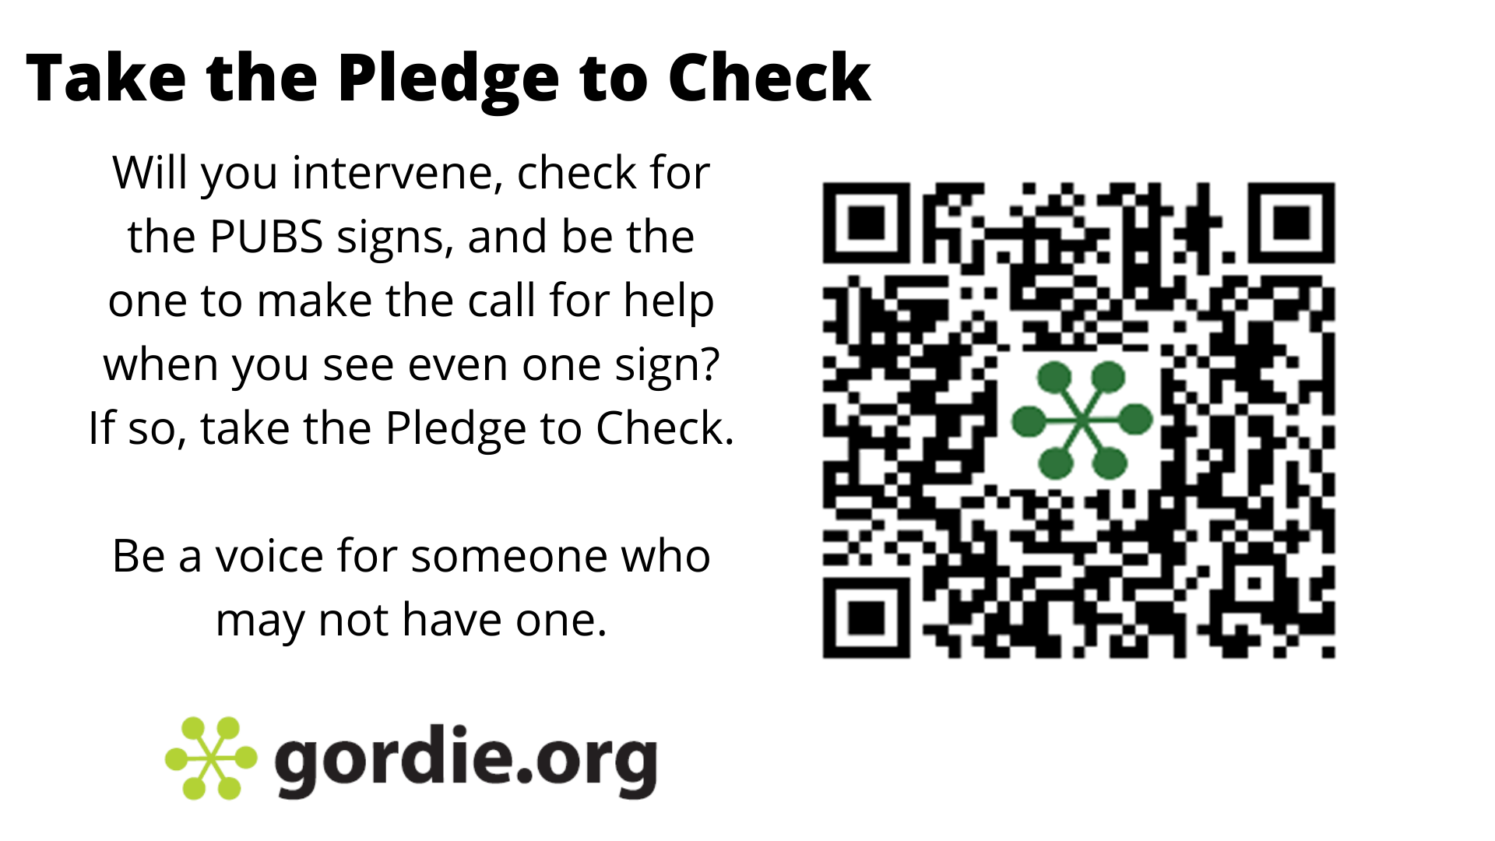
Notes:
Are you willing to take the Pledge to Check?
Use the QR code to sign online and pledge to know the PUBS signs and call if you see even one.
The Gordie Center website has all of the videos we shared as well as many others.

Slide 27
YOUR CAMPUS RESOURCES HERE
Notes:
FACILITATOR NOTE: add your campus resources on this slide

Slide 28
Notes:
What questions do you have?
Thank everyone for attending and remind them to visit Gordie.org for more information.

