Slide 1
Notes:
The facilitators should introduce themselves, welcome and thank everyone for attending.
Give some information about your personal connection to the issues of alcohol overdose and/or hazing.

Slide 2
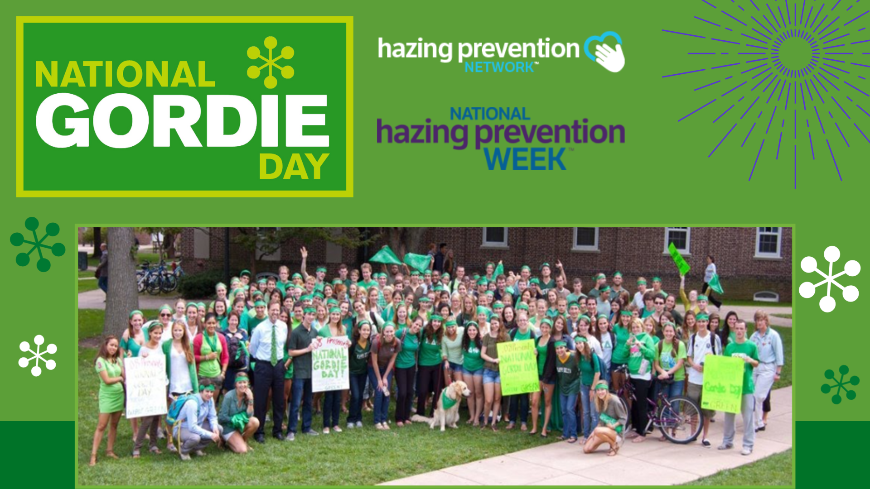
Notes:
National Gordie Day is celebrated every September on the Thursday of National Hazing Prevention Week, which is sponsored by the Hazing Prevention Network.
It serves as a day of remembrance for Gordie Bailey, and a way to raise awareness about the dangers of hazing and alcohol overdose.

Slide 3
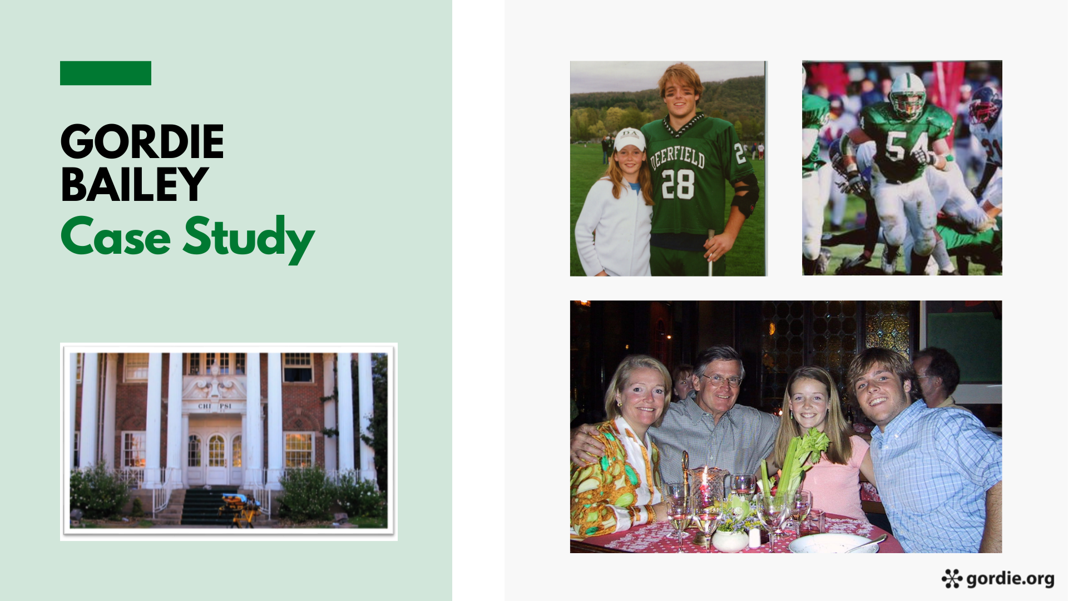
He had a younger sister who adored him and was close to his parents and step-parents.
In high school, he created a Hug Club with his friends because he thought any problem could be solved with a hug.
He was always making everyone laugh, played guitar, acted in school plays, and made films for fun.
He called his parents to share the news that he accepted the bid and would be going to his first event that night,
Gordie was excited about both groups and was feeling confident about fitting in at a school far from home.
Gordie Bailey died in his third week of college. He was 18 years old.
Gordie was a friendly, well-liked, funny, athletic guy.
His family fully expected him to be an actor or film director someday.
In his third week of college, Gordie received a bid to join a fraternity.
and also that he had been chosen for the club lacrosse team.
Notes:
PRESENTER NOTE: This slide contains an embedded audio file that will play automatically upon switching to this slide. The slide also contains closed captioning that will appear across the bottom of the slide. Should there be an issue with the audio, the full script of the audio files is below. If you are presenting via an online participant response systems (e.g., Mentimeter.com), you can replace this slide and the next with a video the Gordie Center created of these 2 slides, including their audio content and closed captioning, using this YouTube link: https://youtu.be/L24lYY_0NtQ
Audio script:
Gordie Bailey died in his 3rd week of college. He was 18 years old.
Gordie was a friendly, well-liked, funny, athletic guy. He had a younger sister who adored him and was close to his parents and step-parents. In high school, he created a Hug Club with his friends, because he thought any problem could be solved with a hug. He was always making everyone laugh, played guitar, acted in the school plays, and made films for fun. His family fully expected him to be an actor or film director someday.
In his 3rd week of college, Gordie received a bid to join a fraternity. He called his parents to share the news that he accepted the bid and would be going to his first event that night and also that he had been chosen for the club lacrosse team. Gordie was excited about both groups and was feeling confident about fitting in at a school far from home.

Slide 4
That evening, Gordie and 26 other fraternity pledges, dressed in coats and ties for bid night,
were blindfolded and taken to the woods far from campus to meet with fraternity alumni.
The pledges were given four handles of whiskey and six bottles of wine to drink around a bonfire.
The pledges were told they needed to finish the alcohol before their ride back to the fraternity house left in 30 minutes.
Fraternity brothers and pledges wrote all over his body with permanent markers --
A fellow pledge (who had thrown up multiple times from drinking too much alcohol during the event)
checked on Gordie around 4 AM before leaving the fraternity house to walk back to their dorm.
He was face down on the floor next to the couch. He wasn't breathing. His face was blue.
When the group returned to the fraternity house, Gordie was visibly drunk
and was placed on a couch to "sleep it off," with a bucket in case he threw up.
It was 11 PM.
a fraternity ritual meant to embarrass brothers who pass out.
He heard Gordie snoring loudly, assumed Gordie was okay, and left.
When the brothers next checked on Gordie at 9 AM, he was already gone.
His blood alcohol content, or BAC, was five times the legal limit.
No one called for help until it was too late.
Notes:
PRESENTER NOTE: This slide contains an embedded audio file that will play automatically upon switching to this slide. The slide also contains closed captioning that will appear across the bottom of the slide. Should there be an issue with the audio, the full script of the audio files is below. If you are presenting via an online participant response systems (e.g., Mentimeter.com), you can replace this slide and the previous slide with a video the Gordie Center created of these 2 slides, including their audio content and closed captioning, using this YouTube link: https://youtu.be/L24lYY_0NtQ
Audio script:
That evening, Gordie and twenty-six other fraternity pledges, dressed in coats and ties for bid night, were blindfolded and taken to the woods far from campus to meet with fraternity alumni. The pledges were given four handles of whiskey and six bottles of wine to drink around a bonfire. The pledges were told they needed to finish the alcohol before their ride back to the fraternity house left in 30 minutes.
When the group returned to the fraternity house, Gordie was visibly drunk and was placed on a couch to "sleep it off“ with a bucket in case he threw up. It was 11pm. Fraternity brothers and pledges wrote all over his body with permanent markers--a fraternity ritual meant to embarrass brothers who pass out. A fellow pledge (who had thrown up multiple times from drinking too much alcohol during the event) checked on Gordie around 4am before leaving the fraternity house to walk back to their dorm. He heard Gordie snoring loudly, assumed Gordie was okay, and left. When the brothers next checked on Gordie at 9am, he was already gone. He was face down on the floor next to the couch. He wasn’t breathing. His face was blue. His blood alcohol content (or BAC) was 4 times the legal limit. No one called for help until it was too late.

Slide 5
Notes:
Since January 1, 2000, over 100 people have lost their lives due to hazing in the U.S. EACH death was completely preventable.
Gordie’s death could have been prevented at many different times the night he died.
Even if someone doesn’t die, the hidden psychological harm of hazing “traditions” can last a lifetime.
We want you to learn what you could do if you’re in a similar situation.

Slide 6
Notes:
Gordie might not have consumed so much alcohol if the activity hadn’t also included hazing.
ASK → How would you define hazing?
Gather a few responses, using one of the formats below:
Use an online participant response systems (e.g., Mentimeter.com) to receive real-time responses and show them through your PowerPoint slides. A basic Mentimeter account is free.
Ask students to turn to a neighbor and share their thoughts, then ask for volunteers to share with the whole group. If delivering the program online, put students in breakout rooms, and ask for one person to submit a group response through chat once everyone returns to the main room.
Ask the entire group for ideas on what hazing is and invite students to share their thoughts. If delivering online, invite students to submit through chat.

Slide 7
Notes:
Let’s make sure we all have a basic understanding of what hazing is:
There are 3 components:
Group context (related to joining or maintaining membership in a group)
Humiliating, degrading, or endangering behavior
Regardless of consent
ASK: “What do you notice, find interesting, or find confusing about this statement?”
Most groups will focus on consent and the phrase: "regardless of a person’s willingness to participate” as something they had not really considered before.

Slide 8
Hazing signs: Worried about a friend
Notes:
The Gordie Center created a video to help students know how to know when a friend might be experiencing hazing and what they can do.
Direct URL: https://youtu.be/um2xLIxF8ng

Slide 9
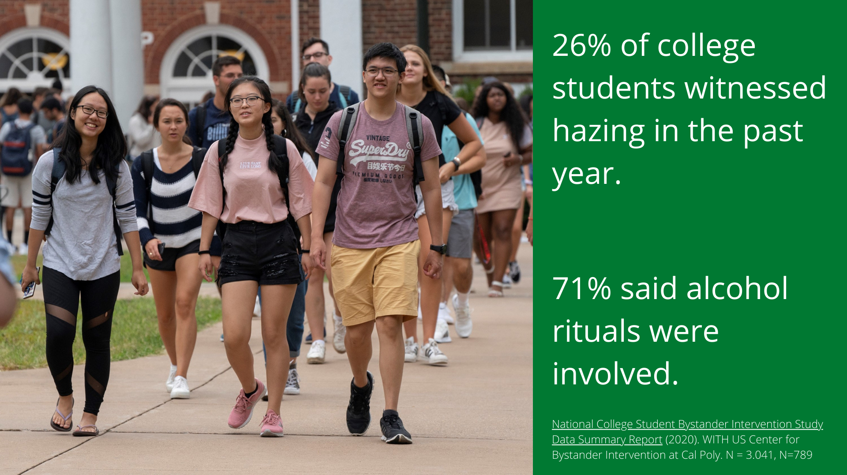
Notes:
In a national survey of college student bystander behavior, over a quarter of students said they had seen hazing on their campus.
In most cases, alcohol was involved.
Citation: National College Student Bystander Intervention Study Data Summary Report (2020). WITH US Center for Bystander Intervention at Cal Poly. N = 3.041, N=789
https://global-uploads.webflow.com/5ba1264a5a1f9d4953de4829/6035cb76afd6d7141fa25df2_NCBIS%20Survey%20Summary%20Report%202020.pdf

Slide 10
Notes:
Although not all hazing involves alcohol use, it is the most frequent reason of hazing-related death.
In a national survey of hazing experiences, alcohol was involved in two of the three most frequent hazing behaviors.
Citation: Allan, E.J. and Madden, M. (2008) Hazing in View: College Students at Risk
https://stophazing.org/wp-content/uploads/2020/12/hazing_in_view_study.pdf

Slide 11
Notes:
Now that you know more about hazing and alcohol, we're going to talk about what you can do.

Slide 12
Notes:
ASK → What makes it difficult to intervene in alcohol situations?
Gather a few responses, using one of the formats below:
Use an online participant response systems (e.g., Mentimeter.com) to receive real-time responses and show them through your PowerPoint slides. A basic Mentimeter account is free.
Ask students to turn to a neighbor and share their thoughts, then ask for volunteers to share with the whole group. If delivering the program online, put students in breakout rooms, and ask for one person to submit a group response through chat once everyone returns to the main room.
Ask the entire group for ideas on what hazing is and invite students to share their thoughts. If delivering online, invite students to submit through chat.
Most groups will mention a fear of getting in trouble and not knowing if a situation is truly an emergency.
Mention that marginalized groups may be more hesitant to call 911. What does your campus do to address this concern?

Slide 13
PUBS sign of alcohol overdose
Notes:
Many of you mentioned that you’re not sure when a situation is truly an emergency.
The Gordie Center worked with students to create the PUBS acronym to teach the 4 signs of overdose and when to call 911 to save someone’s life.
Direct URL: https://youtu.be/ycwyLPgUunc5

Slide 14
Notes:
Even if someone doesn’t have a PUBS sign when you first check on them, know that Blood Alcohol Concentration (BAC) can continue to rise even after someone passes out.
It’s important to continue to monitor the person for PUBS at least every 10-15 minutes until their condition improves.
Never put a backpack on a person, as they could roll over on their stomach, and suffocate if they vomit.
If at any point, you are unsure about their medical condition, call 911.
You an also call the national Poison Center (1-800-222-1222) to be connected to your local center. They provide free, expert medical advice 24/7.

Slide 15
Notes:
Another reason bystanders hesitate to call for help is they are afraid of getting in trouble.
Medical Amnesty state laws and campus policies can protect you from arrest, prosecution or disciplinary action if you call for help related to an alcohol or other drug overdose, even if you or the victim is underage or using other drugs.

Slide 16
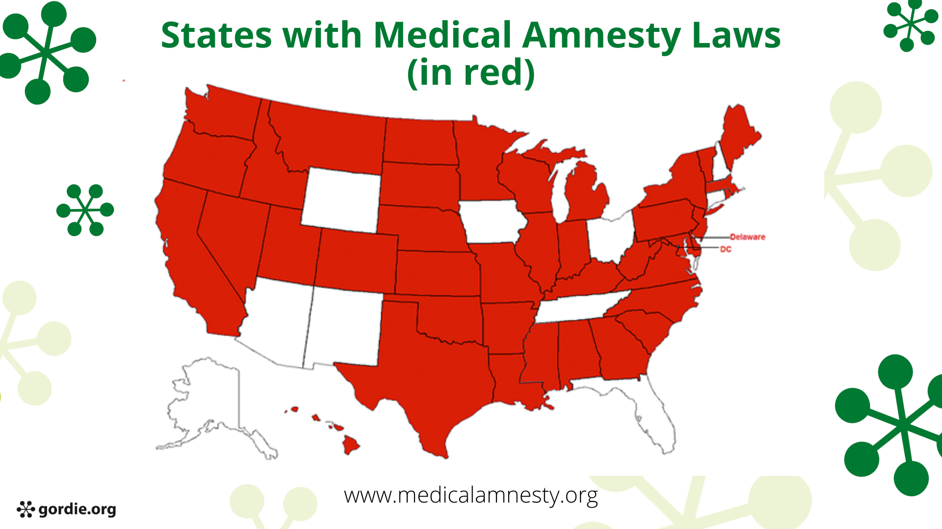
Medical amnesty map
Notes:
Most states have medical amnesty laws that protect callers from being prosecuted for underage drinking or drug use. States in red have medical amnesty laws.
(Only 9 states do NOT have medical amnesty laws.)
NOTE: If you go to the Medical Amnesty Initiative website, you can click on your state to find the text of your state law. Include a summary of your state law as a separate slide.
www.medicalamnesty.org

Slide 17
YOUR STATE LAW HERE
Notes:
FACILITATOR NOTE: add your state’s medical amnesty law from www.medicalamnesty.org. If you do not have a medical amnesty law, delete this slide or provide information on www.medicalamnesty.org on how to advocate for a medical amnesty law in your state.

Slide 18
YOUR CAMPUS POLICY HERE
Notes:
FACILITATOR NOTE: add your campus medical amnesty policy on this slide. If you do not have a medical amnesty policy, delete this slide.

Slide 19
Notes:
We know from a national survey that the primary reason students take action as active bystanders is because they are following their inner compass – they know it’s just the right thing to do.
Citation: Step UP! Bystander Intervention Program Pilot Survey (2006). https://stepupprogram.org/docs/STEPUP_AppendixC_PilotSurvey.pdf

Slide 20
Notes:
Now that you know more about hazing and how to identify alcohol overdose through PUBS, we hope you’ll take action to be an active bystander.
Your actions could save a life!

Slide 21
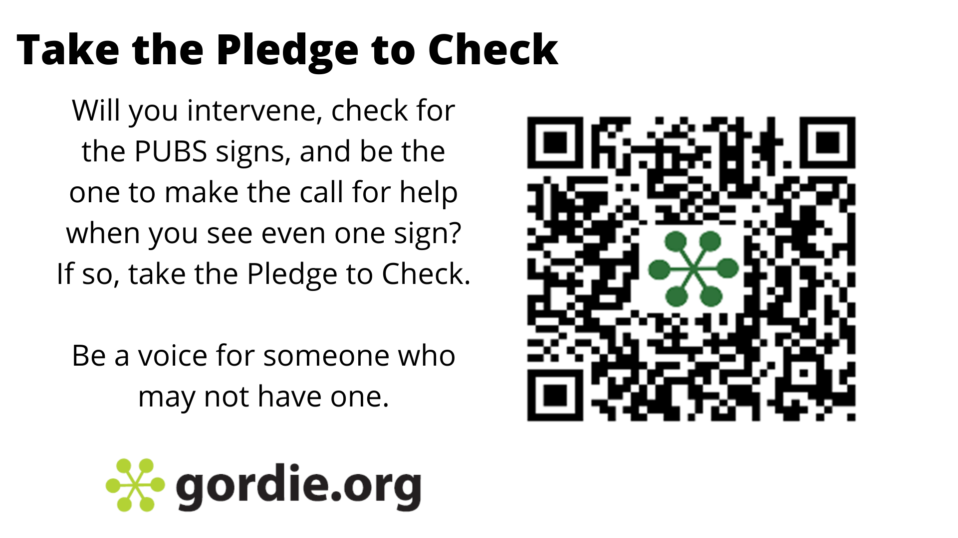
Notes:
Are you willing to take the Pledge to Check?
Use the QR code to sign online and pledge to know the PUBS signs and call if you see even one.
The Gordie Center website has all of the videos we shared as well as many others.

Slide 22
YOUR CAMPUS RESOURCES HERE
Notes:
FACILITATOR NOTE: add your campus resources on this slide

Slide 23
Notes:
What questions do you have?
Thank everyone for attending and remind them to visit Gordie.org for more information.

